Slide 1
Introduction to Machine Learning and its Concepts
Assignment 6
Agile Software Engineering
Ramya Raga. N
BSc Hons (A)

Slide 2
What is Machine Learning?
Machine Learning is a branch of AI that concentrates on creating algorithms and models capable of learning from data and making predictions or decisions, without the need for explicit programming.

Slide 3
Why is machine learning important?
Machine Learning is vital as it enables automated analysis of large datasets, discovers hidden patterns, personalizes recommendations, detects fraud, advances healthcare, and empowers autonomous systems. Its impact spans industries, enhancing decision-making, user experiences, and innovation.

Slide 4
Types of Machine Learning
Supervised Learning
Unsupervised Learning
Reinforcement Learning

Slide 5
Supervised Learning
Supervised Learning is a Machine Learning approach where an algorithm learns from labeled data. It undergoes training using input data and corresponding target labels, discovering patterns and relationships. Once trained, the algorithm can predict or classify new data based on its acquired knowledge.

Slide 6
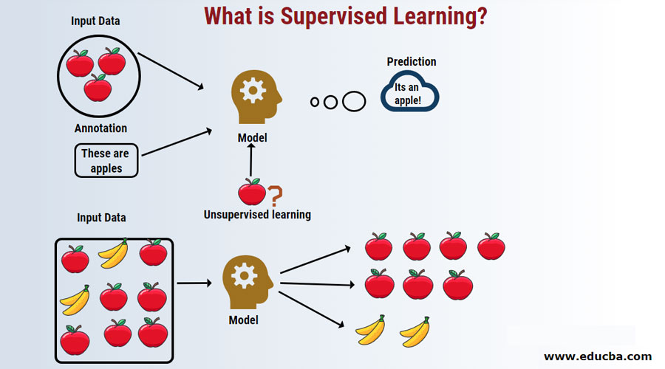

Slide 7
Supervised Learning
Linear Regression
Decision Trees
Support Vector Machines

Slide 8
Linear Regression
In linear regression, the objective is to determine the optimal line that minimizes the disparity between predicted and actual values. This line is established by estimating coefficients or weights for each independent variable. These coefficients indicate the line's slope and intercept, influencing how the dependent variable responds to changes in the independent variables.

Slide 9
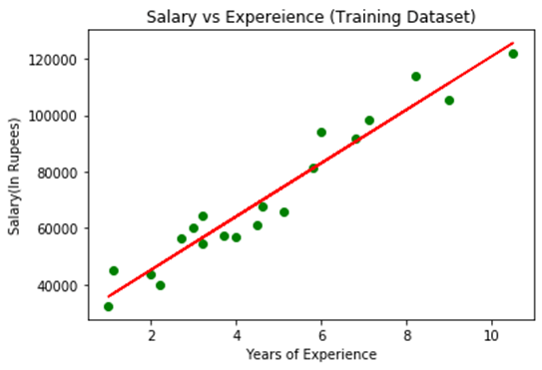

Slide 10
Decision Trees
The decision tree algorithm constructs a tree-shaped structure by dividing data based on various features and their values. It prioritizes the most informative features to make optimal splits. The objective is to create a tree that effectively separates classes or minimizes prediction errors in regression tasks.

Slide 11
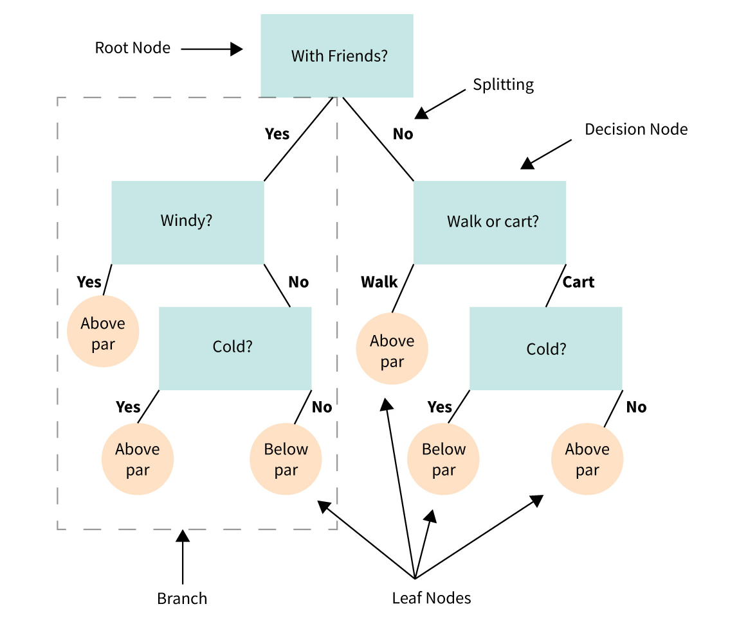

Slide 12
Support Vector Machines
SVM works by finding the best possible line or boundary (known as the hyperplane) that separates different classes of data points. The goal is to maximize the margin, which is the distance between the hyperplane and the nearest data points from each class. By maximizing the margin, SVM aims to achieve better generalization and improve its ability to classify new, unseen data accurately.

Slide 13
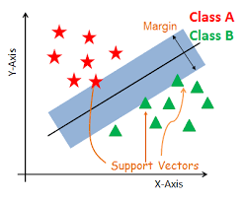

Slide 14
Unsupervised Learning
Unsupervised Learning is a subset of Machine Learning that focuses on extracting patterns and structures from unlabeled data. Unlike supervised learning, it does not rely on predefined target labels. Instead, its objective is to uncover inherent patterns, relationships, and clusters within the data.

Slide 15
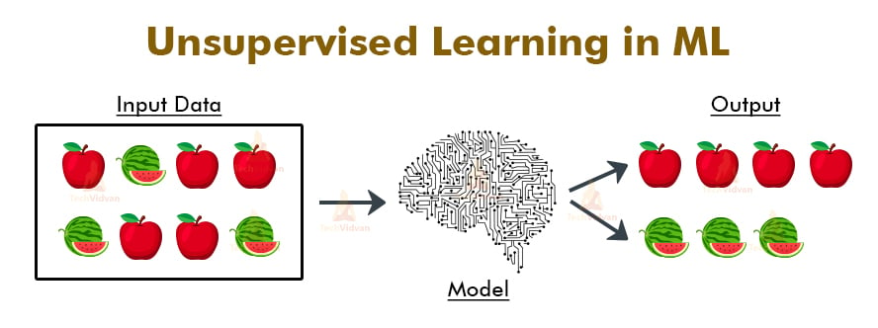

Slide 16
Unsupervised Learning
Clustering
Dimensionality Reduction

Slide 17
Clustering
Clustering is a key technique in unsupervised learning that involves grouping similar data points based on their inherent similarities or distances. Its goal is to identify natural clusters or categories within the data, without prior knowledge of class labels.

Slide 18
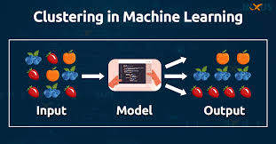

Slide 19
Dimensionality Reduction
Dimensionality reduction is a technique used in machine learning to reduce the number of features or variables in a dataset while preserving the important information. It addresses the problem of high-dimensional data, where the presence of numerous features can lead to increased computational complexity, overfitting, and difficulties in visualization.

Slide 20
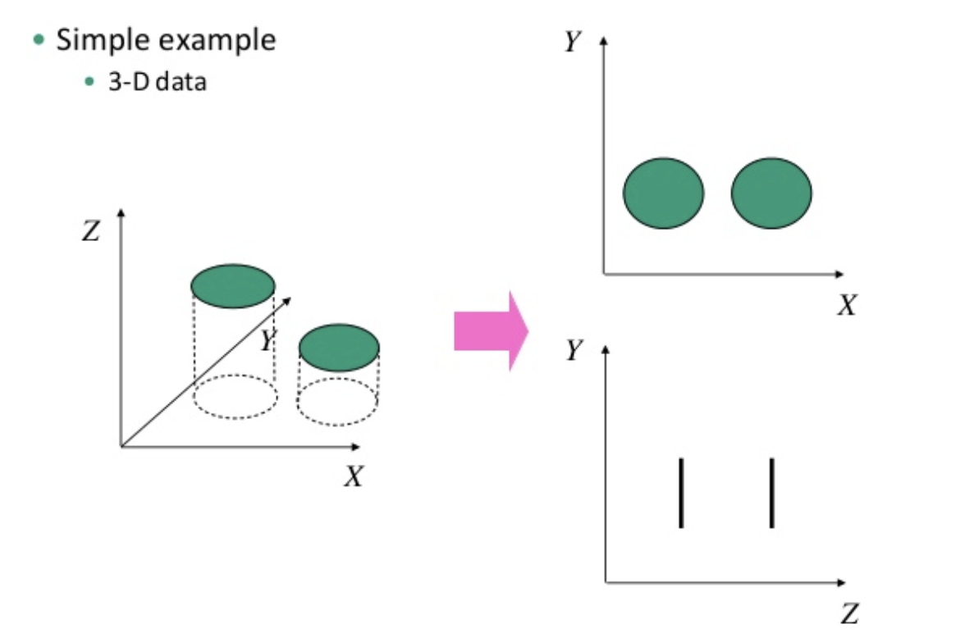

Slide 21
Reinforcement Learning
In reinforcement learning, the agent learns through a trial-and-error process. It interacts with the environment, takes actions, receives feedback in the form of rewards or penalties, and adjusts its actions based on the received feedback. The goal is to learn an optimal policy that determines the best actions to take in different situations to maximize long-term rewards.

Slide 22
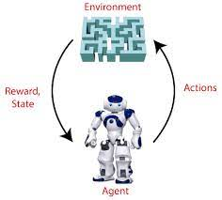

Slide 23
Reinforcement Learning
Q-Learning
Deep Q-Networks

Slide 24
Q-Learning
It is based on the concept of Q-values, which represent the expected future rewards an agent can obtain by taking a particular action in a given state.

Slide 25
Deep Q-Networks
In DQN, a deep neural network is used to estimate the Q-values instead of maintaining a lookup table as in traditional Q-Learning. The network takes the state as input and outputs Q-values for each possible action.

Slide 26
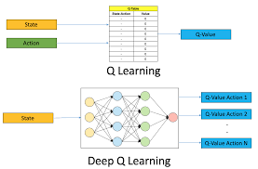

Slide 27
Key Concepts in Machine Learning
Training Data
Features and Labels
Model Training
Model Evaluation
Prediction and Inference

Slide 28
Classification Algorithms
Logistic Regression
Naive Bayes
Decision Trees
Random Forest
Support Vector Machines (SVM)
K-Nearest Neighbors (KNN)

Slide 29
Logistic Regression
A statistical algorithm that models the relationship between the input features and the probability of belonging to a specific class.

Slide 30
Naive Bayes
Based on Bayes' theorem, this algorithm assumes independence among the features and calculates the probability of each class given the input features.

Slide 31
Decision Trees
A tree-like model where internal nodes represent features, branches represent decisions, and leaf nodes represent classes. The algorithm splits the data based on feature values to create a hierarchy of decisions.

Slide 32
Random Forest
An ensemble method that combines multiple decision trees. Each tree is built on a subset of the training data with random feature selection. The final prediction is made based on the majority vote of the trees.

Slide 33
Support Vector Machines (SVM)
An algorithm that finds the optimal hyperplane to separate the data into different classes by maximizing the margin between them. SVM can handle both linear and non-linear classification problems.

Slide 34
K-Nearest Neighbors (KNN)
This algorithm classifies data points based on the majority class of their k nearest neighbors. It calculates distances between data points to determine similarity.

Slide 35
Training Data
Training data refers to the set of examples or instances that are used to train a machine learning model. It consists of input data, also known as features or predictors, along with their corresponding target labels (in supervised learning) or without any labels (in unsupervised learning).

Slide 36
Features and Labels
Features (input variables)
Labels (output variable)

Slide 37
Features (input variables)
Features, also referred to as predictors or input variables, are the measurable characteristics or attributes of the data that are used to make predictions or classifications. These features can be numeric or categorical values and represent different aspects or properties of the data. For example, in a housing price prediction model, features could include the number of bedrooms, the square footage, the location, and other relevant factors that influence the price

Slide 38
Labels (output variable)
Labels, also known as target variables or output variables, are the values we want the model to predict or classify based on the provided features. In supervised learning, the training data consists of both features and their corresponding labels. The labels represent the desired or expected outcome or class associated with each set of features. Using the housing price prediction example, the labels would be the actual sale prices of the houses.

Slide 39
Model Training
Model training is the process of teaching a machine learning model to recognize patterns, make predictions, or perform specific tasks. It involves presenting the model with a set of labeled examples called training data and allowing it to learn from those examples.

Slide 40
Model Evaluation
During model evaluation, the model is tested on a separate dataset called the test set. This dataset contains examples that were not used during the training process. The model's predictions are compared to the true labels or known outcomes in the test set to evaluate its accuracy and effectiveness.

Slide 41
Prediction and Inference
Prediction refers to the process of using a trained model to estimate or guess the outcome or value of a specific task. Given a set of input features, the model applies the patterns it learned during training to generate a prediction or outcome. For example, in a spam email detection model, given the content and metadata of an email as input features, the model predicts whether the email is spam or not.

Slide 42
Prediction and Inference
Inference, on the other hand, goes beyond just making predictions. It involves interpreting and understanding the underlying patterns and relationships learned by the model. Inference aims to gain insights and extract meaningful information from the model's predictions. It helps in understanding why certain predictions are made and how different features contribute to those predictions.

Slide 43
Thank You

